Slide 1

Paper Seminar
Published in CVPR 2021
Jeonbuk National University, Korea
Multimedia Lab Under Prof. Park and Prof. Yoon
Mingle Xu
10 April 2021

Slide 2
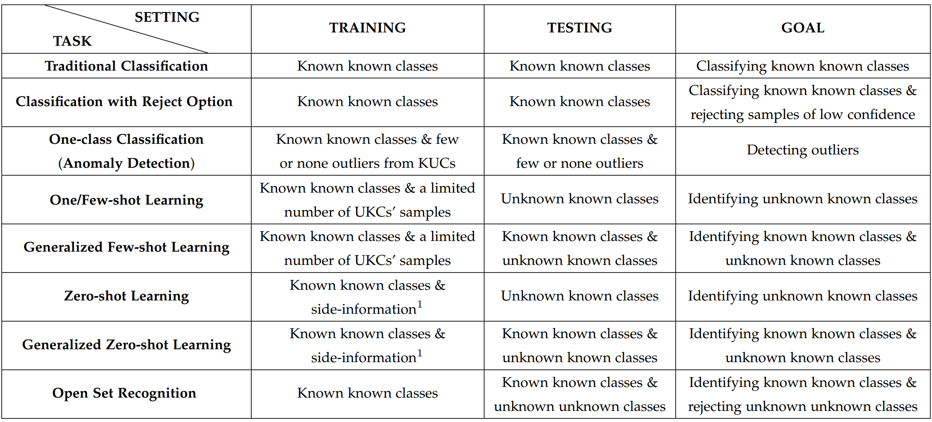
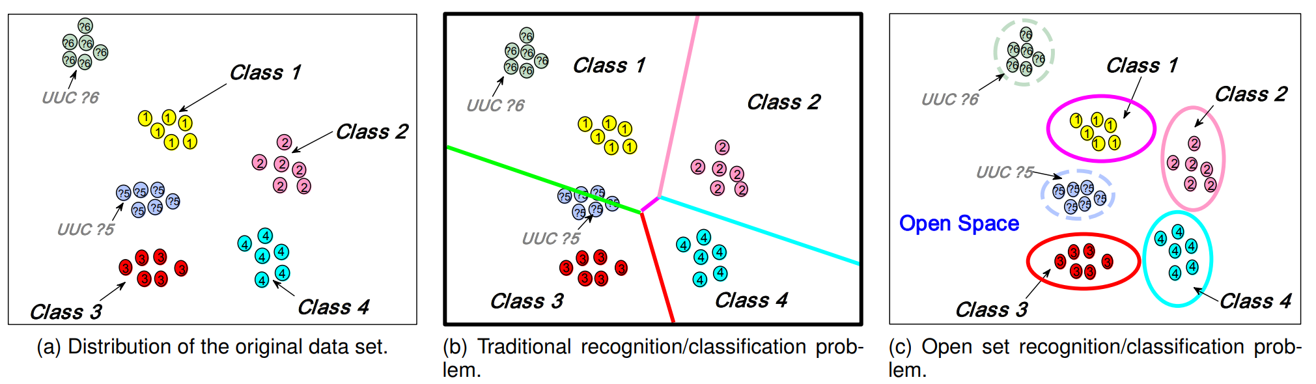
Background

Slide 3
Introduction
Open world object detection
Identify unknown object.
Incrementally learn these identified unknown categories without forgetting previously learned classes when the corresponding labels are progressively received.
Incremental learning: input data is continuously used to extend the existing model's knowledge i.e. to further train the model
Open World Recognition
Open Set Recognition
Novelty Detection
+ Learn the unknown classes
( + incremental learning)
+ Classify the known classes
Binary classifier: known or unknown

Slide 4
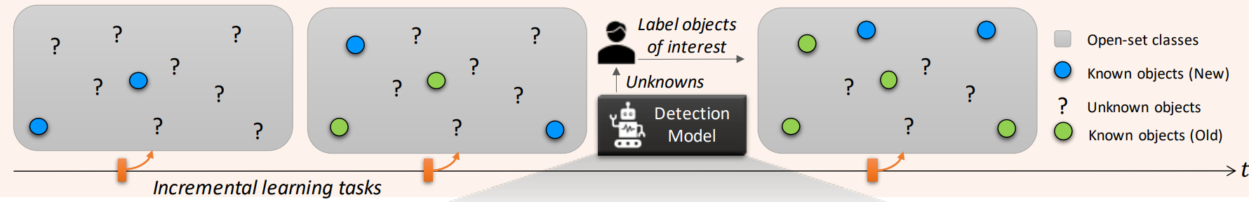
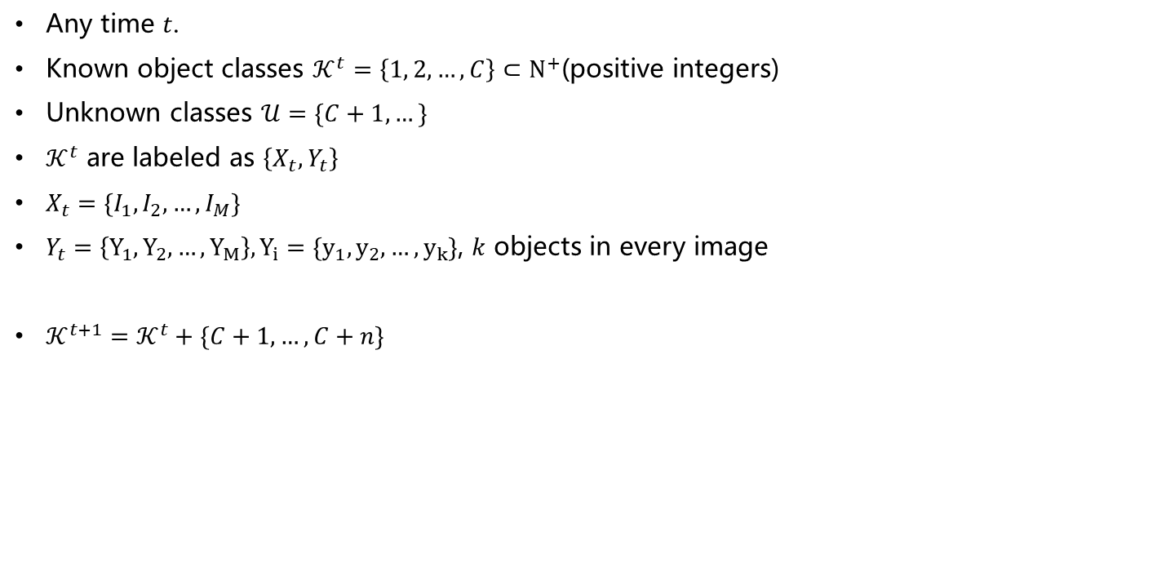
Problem Formalization
Any time $t$.
Known object classes $𝒦^{t}=\left\{1, 2,…,C\right\}⊂Ν^{+}$(positive integers)
Unknown classes $𝒰=\{C+1, …\}$
$𝒦^{t}$ are labeled as $\left\{X_{t},Y_{t}\right\}$
$X_{t}=\{I_{1},I_{2},…,I_{M}\}$
$Y_{t}=\left\{Y_{1},Y_{2},…,Y_{M}\right\}, Y_{i}=\{y_{1},y_{2},…,y_{k}\}$, $k$ objects in every image
$𝒦^{t+1}=𝒦^{t}+\{C+1, …, C+n\}$

Slide 5
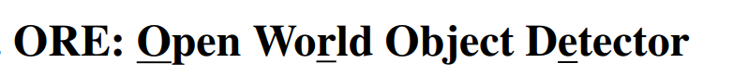
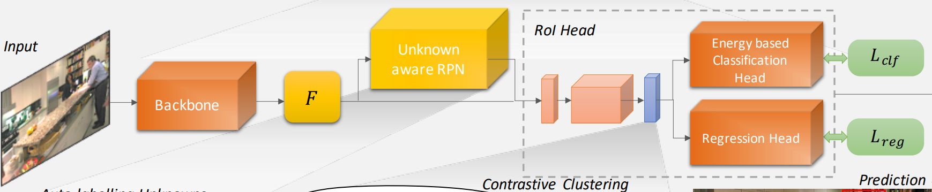
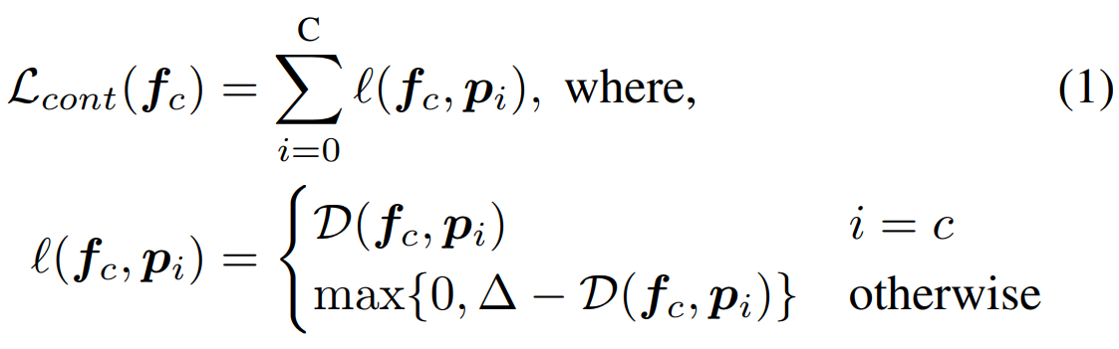
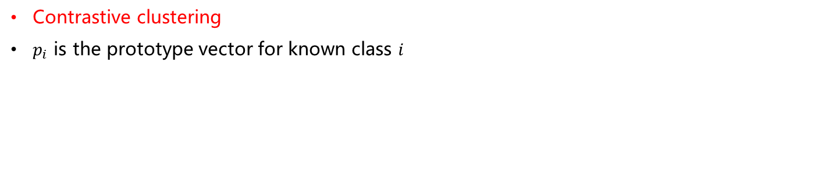
Proposed Method: ORE
Contrastive clustering
$p_{i}$ is the prototype vector for known class $i$

Slide 6
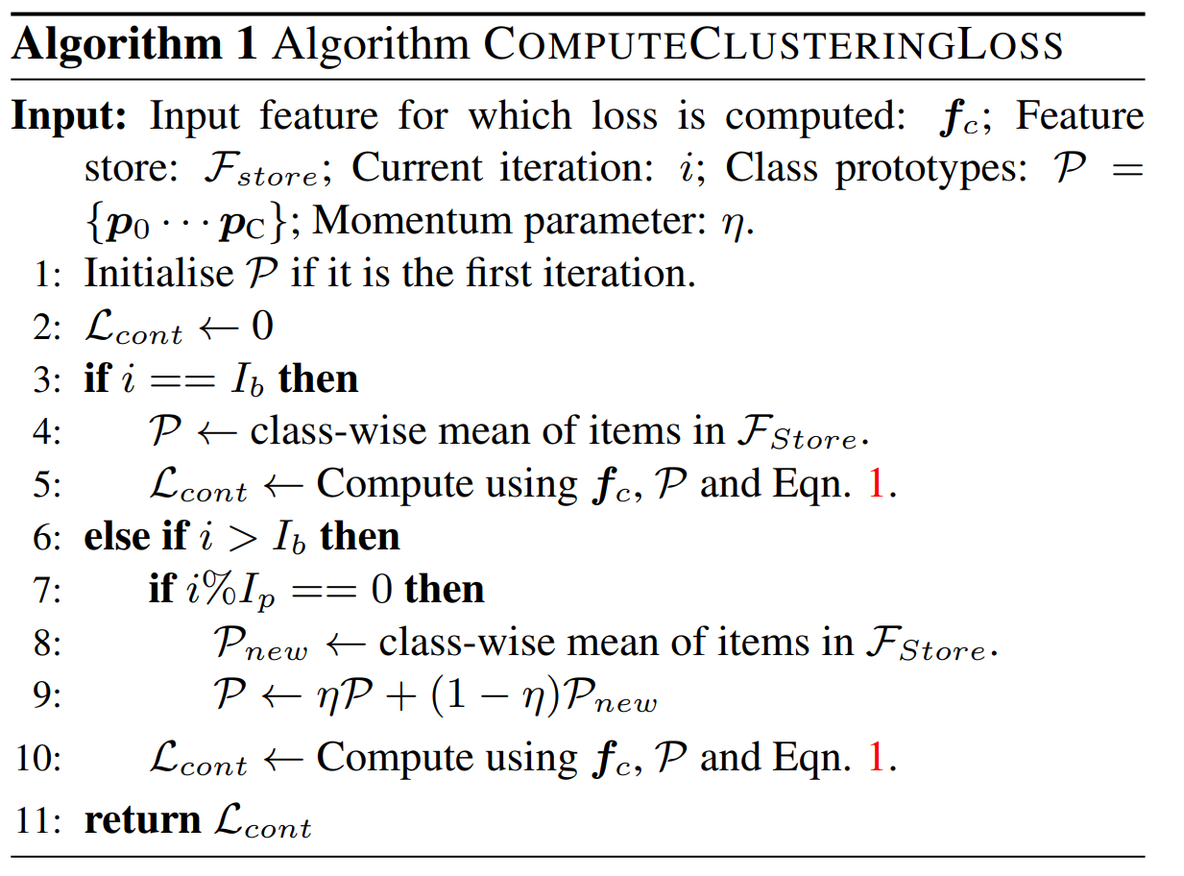
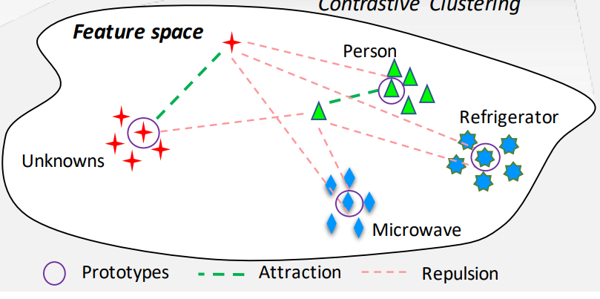
Prototype

Slide 7
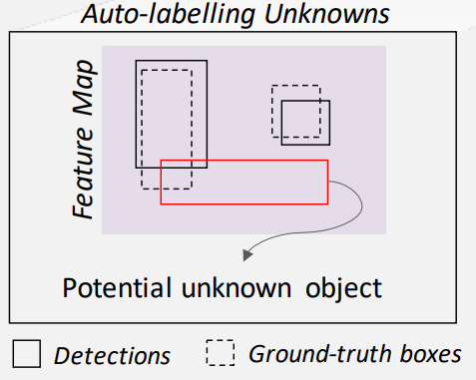
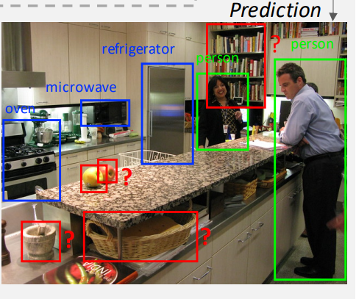
Proposed Method
Auto-labelling Unknowns with RPN
Prototype feature for unknown class
Label those proposals that have high object score, but do not overlap with a ground-truth object as a potential unknown object.

Slide 8
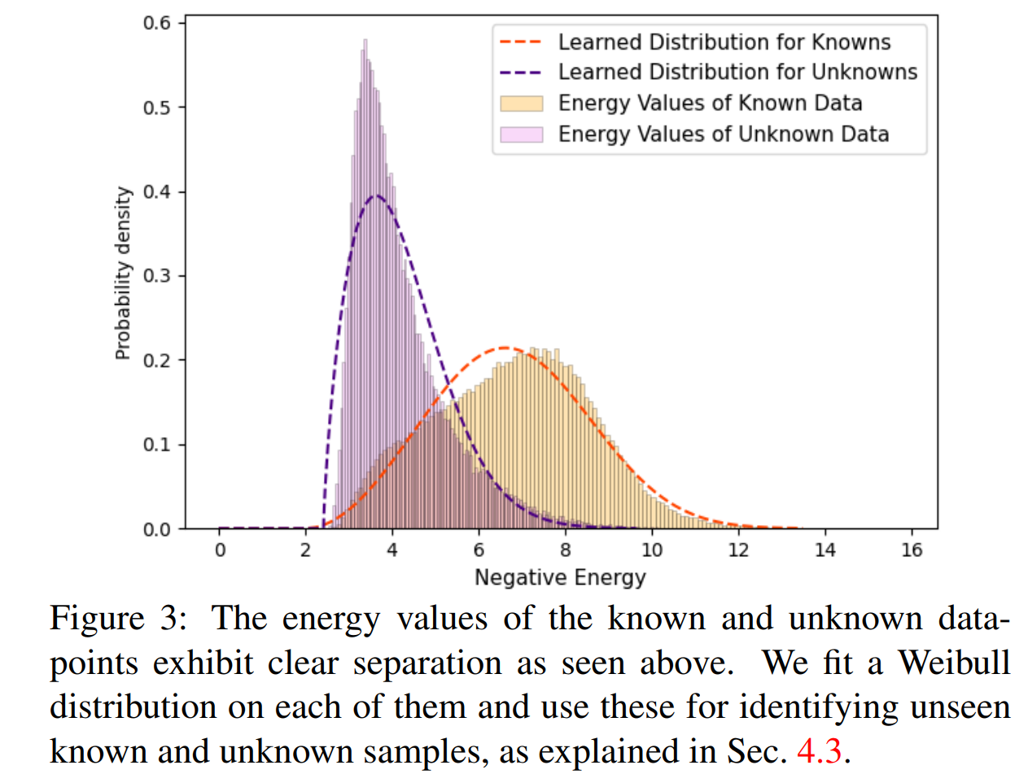
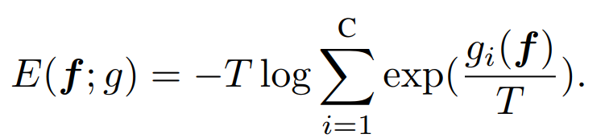
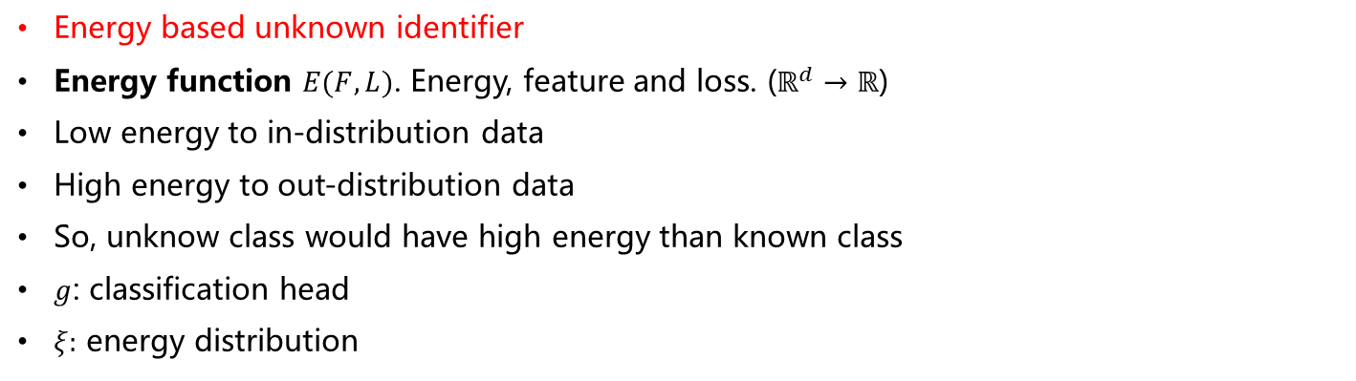
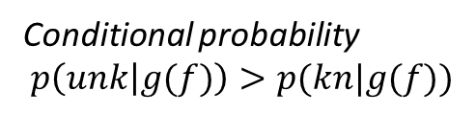
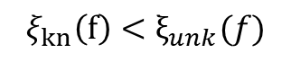
Proposed Method
Energy based unknown identifier
Energy function $E(F,L)$. Energy, feature and loss. ($ℝ^{d}→ℝ$)
Low energy to in-distribution data
High energy to out-distribution data
So, unknow class would have high energy than known class
$g$: classification head
$ξ:$ energy distribution
$$ξ_{kn}\left(f\right)<ξ_{unk}(f)$$
Conditional probability
$$p\left(unk | g(f)\right)>p(kn|g(f))$$

Slide 9
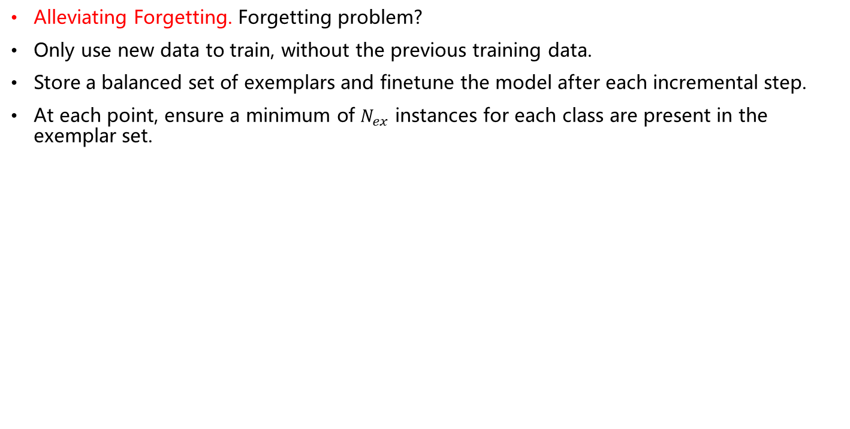
Proposed Method
Alleviating Forgetting. Forgetting problem?
Only use new data to train, without the previous training data.
Store a balanced set of exemplars and finetune the model after each incremental step.
At each point, ensure a minimum of $N_{ex}$ instances for each class are present in the exemplar set.

Slide 10
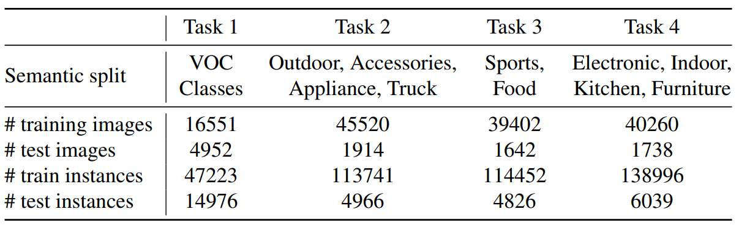
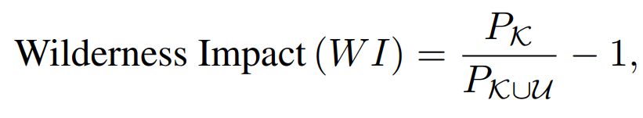
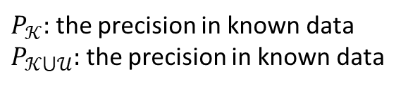
Experiments
Dataset and evaluation metrics
Unknown object is easily gets confused as a known object.
Absolute Open-Set Error (A-OSE): the number count of unknown objects that get classified as the known class.
mAP: incremental learning for new labeled data.
$P_{𝒦}:$ the precision in known data
$P_{𝒦⋃𝒰}:$ the precision in known data

Slide 11
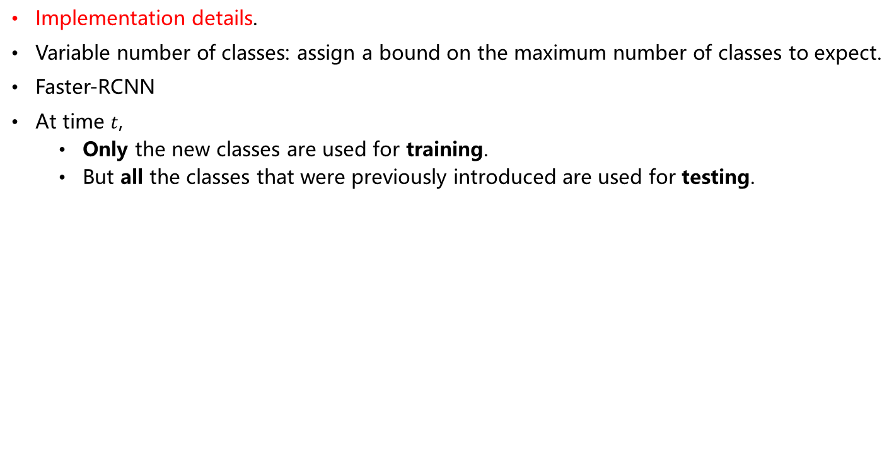
Experiments
Implementation details.
Variable number of classes: assign a bound on the maximum number of classes to expect.
Faster-RCNN
At time $t$,
Only the new classes are used for training.
But all the classes that were previously introduced are used for testing.

Slide 12
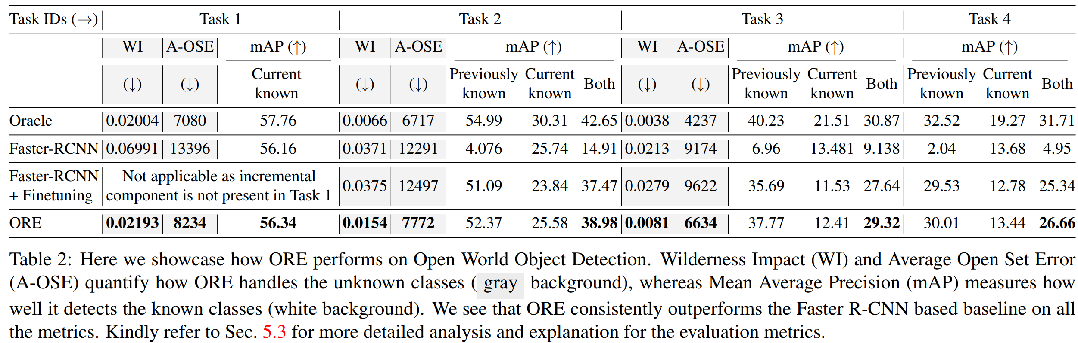
Results
Open World Object Detection Results.
Oracle detector has access to all known and unknown labels at any point.
Oracle: Dataset
Faster-RCNN: the contrasting loss, forgetting

Slide 13
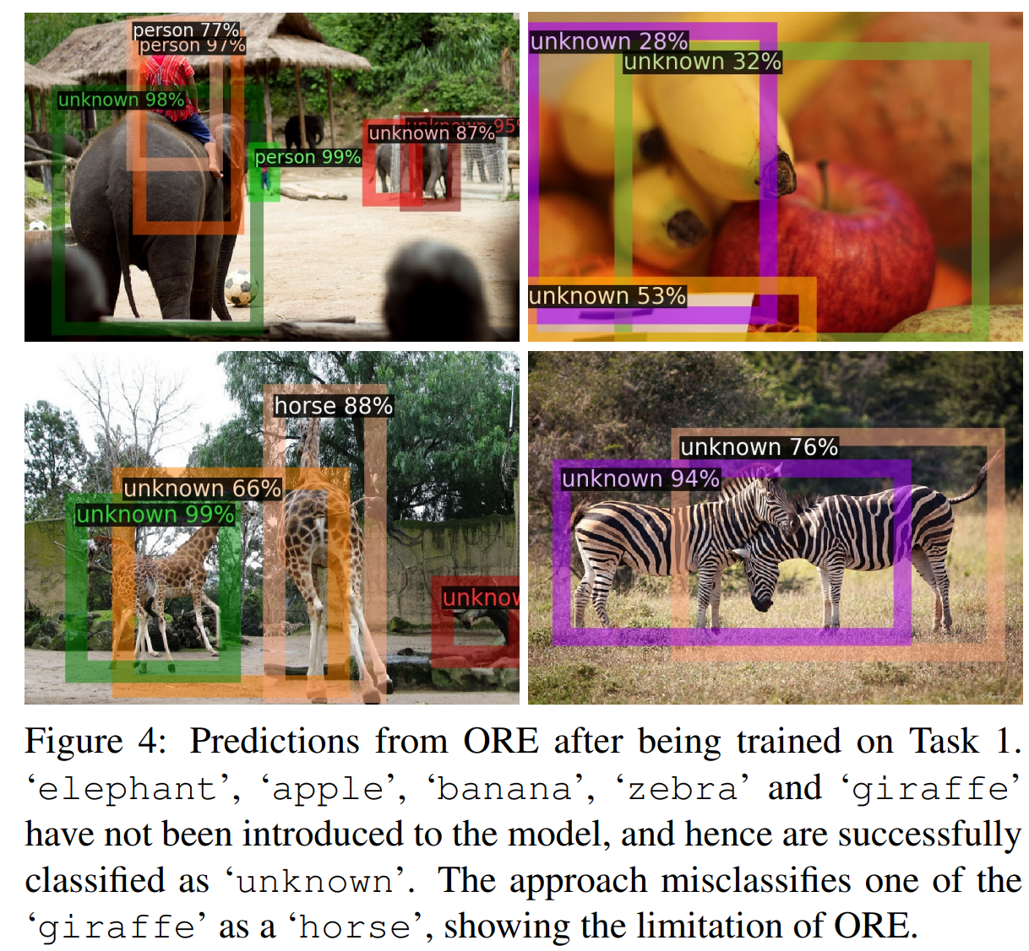

Slide 14
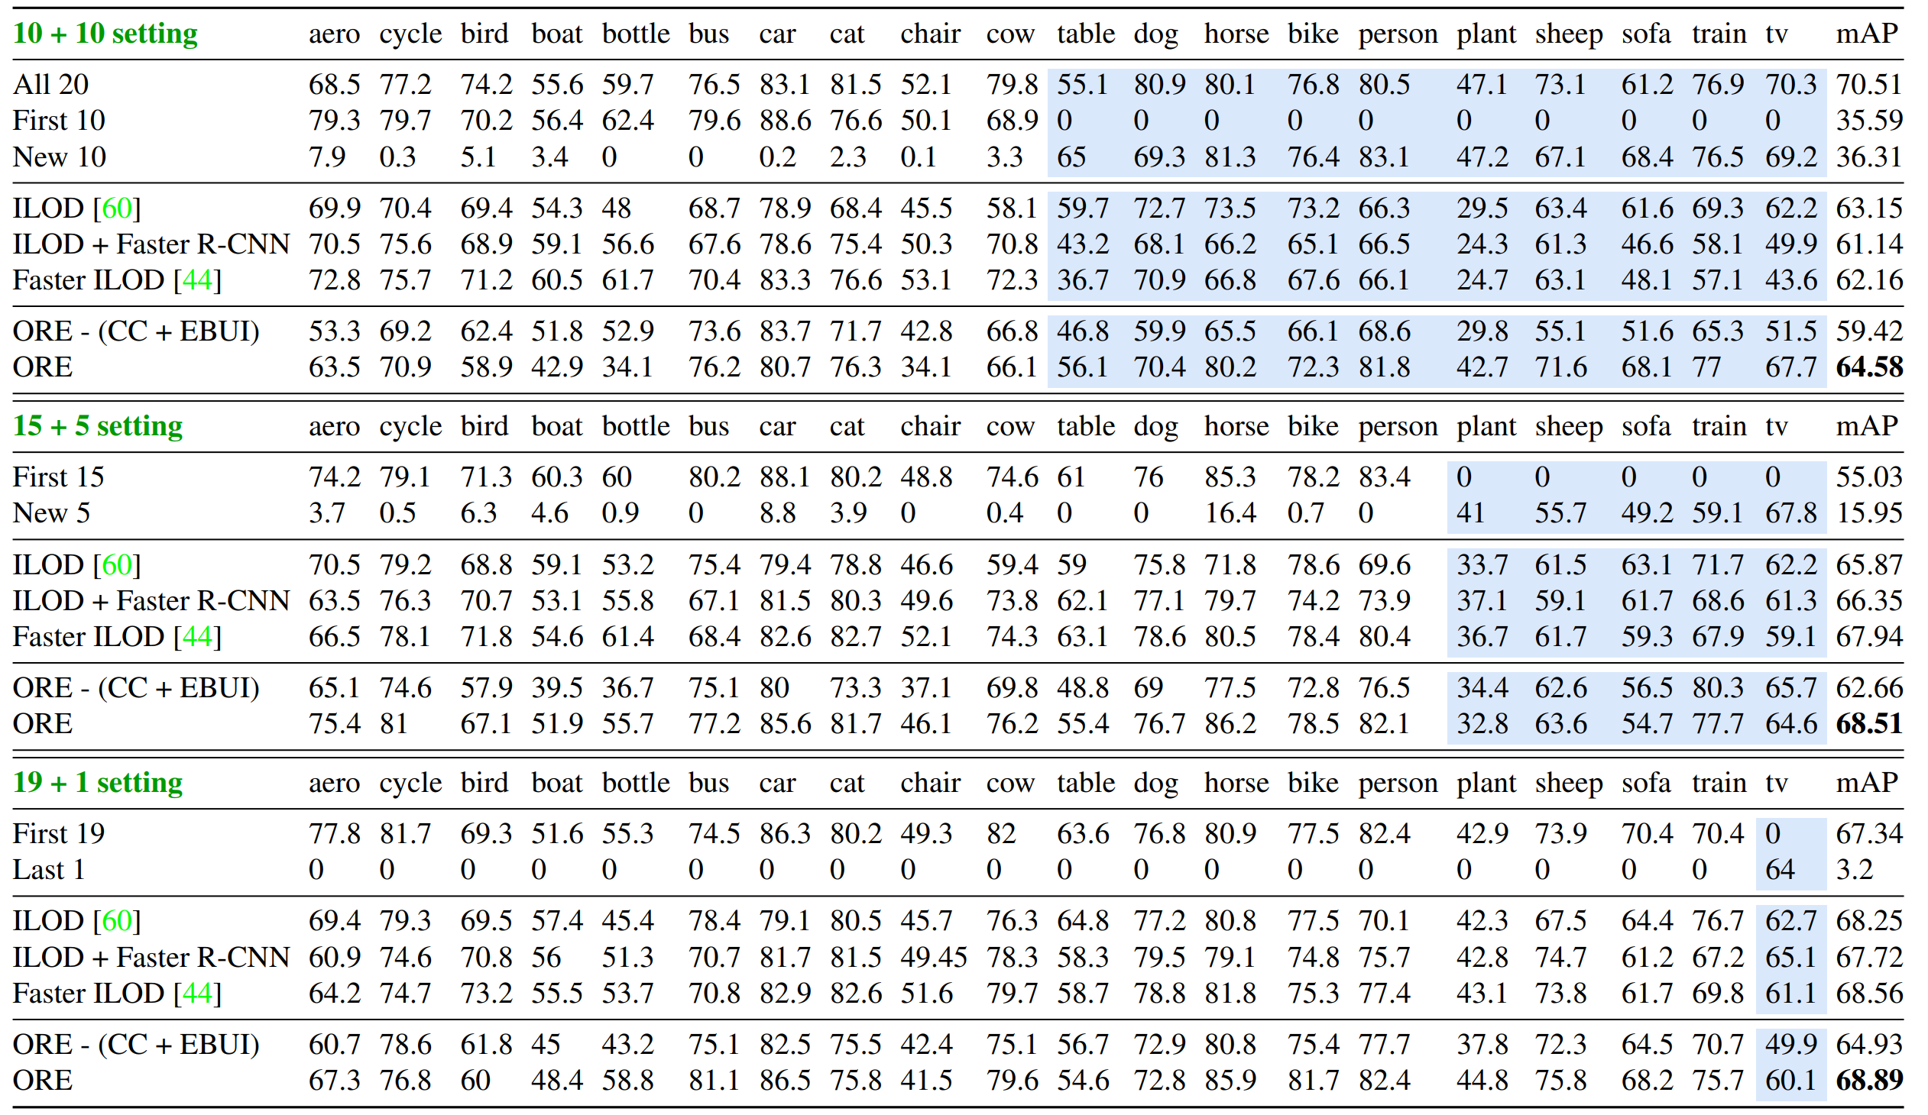
Results
Incremental object detection results
CC: contrastive cluster. EBUI: energy-based unknown identification.

Slide 15
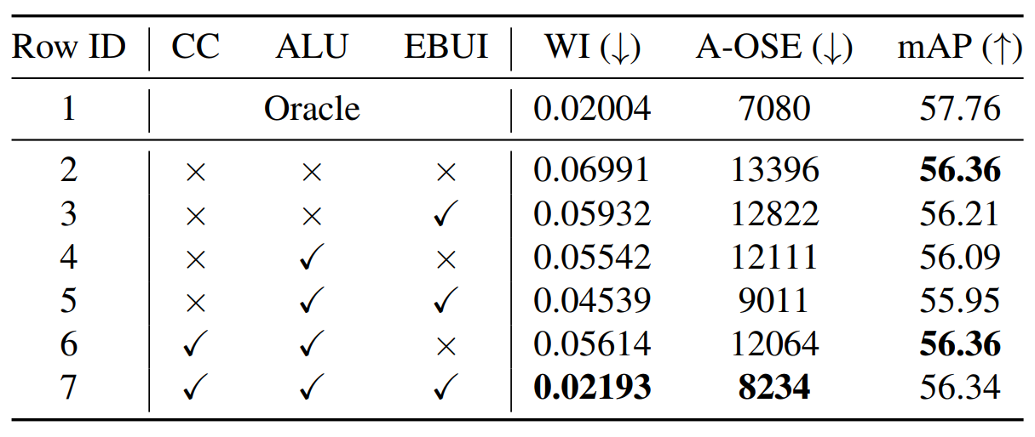
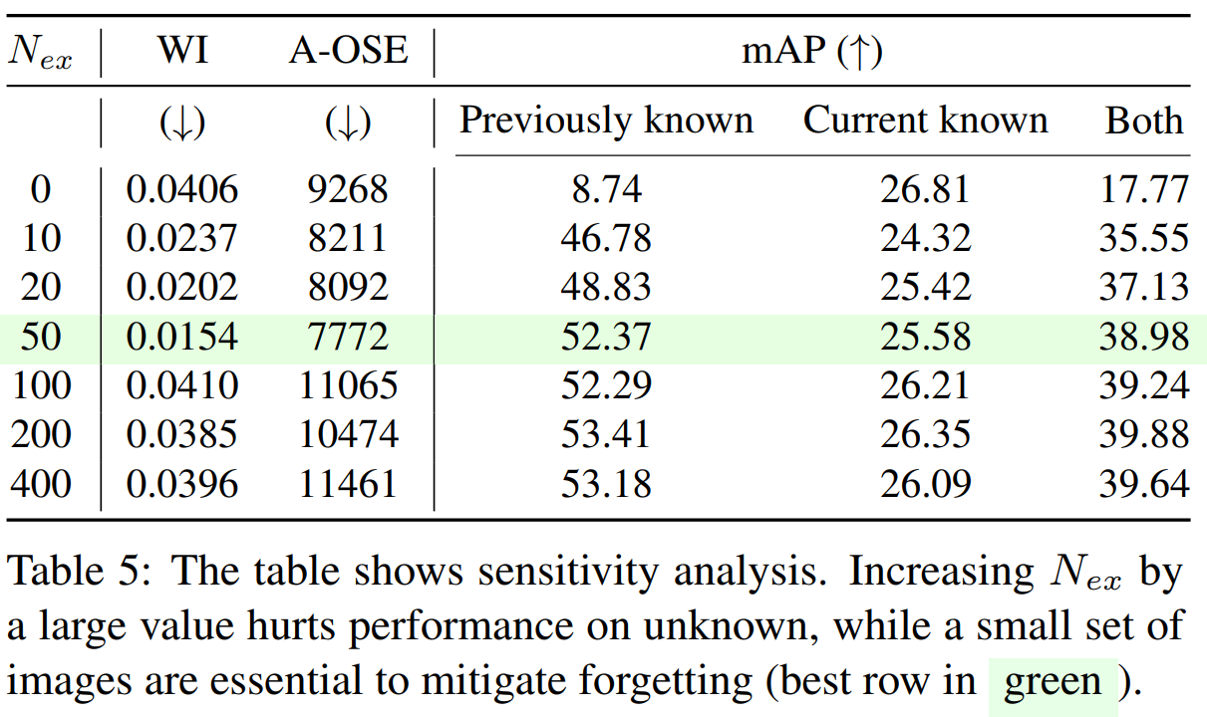
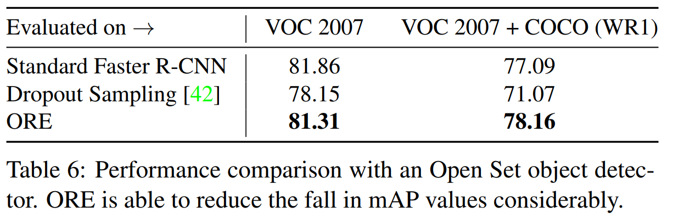
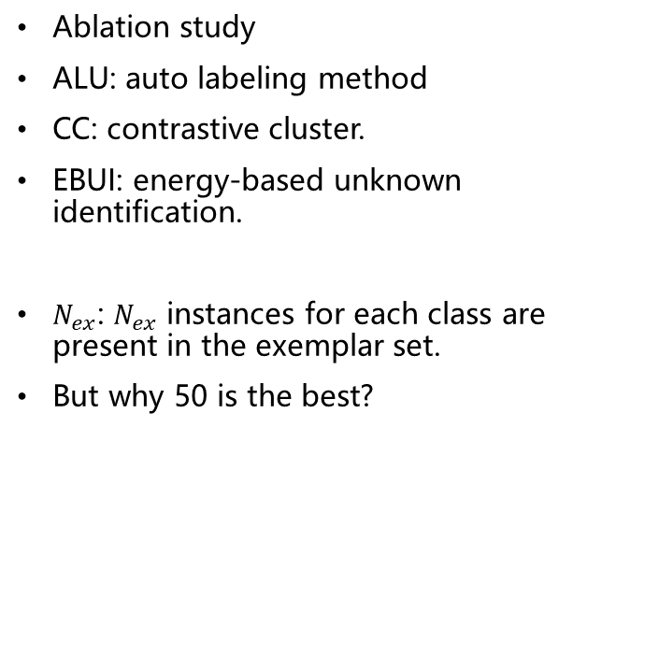
Results
Ablation study
ALU: auto labeling method
CC: contrastive cluster.
EBUI: energy-based unknown identification.
$N_{ex}$: $N_{ex}$ instances for each class are present in the exemplar set.
But why 50 is the best?

Slide 16
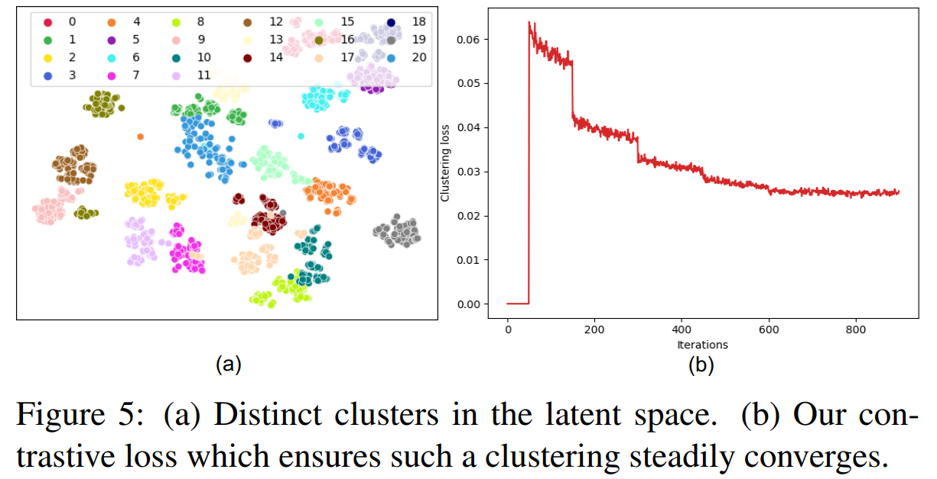
Results
Clustering loss and visualization
Label 20 is unknown class, which is also clustered

Slide 17
Conclusions
New problem: open world recognition
Known or unknown
Classify the known class
Learning the unknown class when the data are received

